Slide 1
An Improved Earliness-tardiness Timing Algorithm
Yann Hendel∗, Francis Sourd
Computers & Operations Research 34 (2007) 2931 – 2938
Presenter: Chiao-Wei Chiu (邱喬偉)
Date: June 27, 2007

Slide 2
Abstract
Earliness–tardiness criteria with distinct due dates usually induce NP-complete problems. Researchers have focused on particular cases like the timing problem, which is to look for the optimal schedule when the jobs sequence is already known. These timing algorithms are very useful since they can be used in more complex procedures. In the first part of this paper we provide the most efficient and fairly general algorithm to solve the one-machine timing problem. It is then adapted to a permutation flowshop problem.

Slide 3
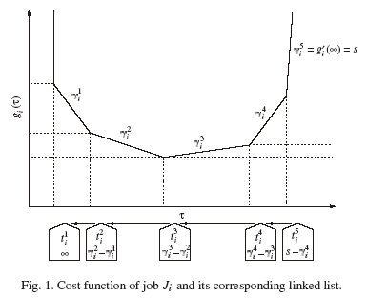


Problem definition
We consider the sequence of n jobs (J₁, . . . , J_{n}) that are to be scheduled in the order of their indices.
For job J_{j}, a cost function f_{i}(C_{i} ) is given where C_{i} is the completion time.
The functions are encoded by the sorted list of their breakpoints and their corresponding slopes.
Our objective is to schedule the jobs in order to minimize the sum of the costs of each job.
isotonic regression

Slide 4
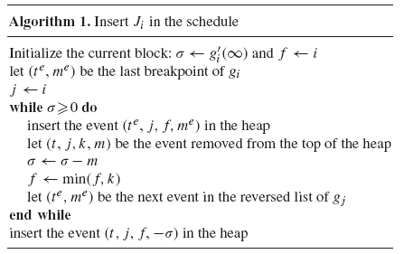
Algorithm 1
The main idea:
  At the ith iteration, to insert job J_{i} processed at time infinity.
  The job is then left-shifted till either it is set at a time when its cost is minimum or it encounters a block and is merged with it.
  The process goes on with this block until it is set at a time where its cost is minimum or it met the preceding block.
  At the end of the iteration, the schedule must be optimal for the first i jobs.
The classic heap operations (insert an event and remove the maximal event) are all done in O(log h) time, where h is the size of the heap.
(t_{j}, j, k, m):
  t_{j} is the abscissa of a breakpoint of a cost function whose index is given by j.
  k is the index of the first job of the block
  m is the modifier of the breakpoint.

Slide 5
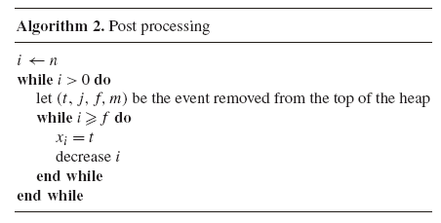
Algorithm 2
Algorithm 2 computes the execution time of each job (starting by the last one) by emptying the heap. The second index f helps to determine all the jobs belonging to the block.

Slide 6
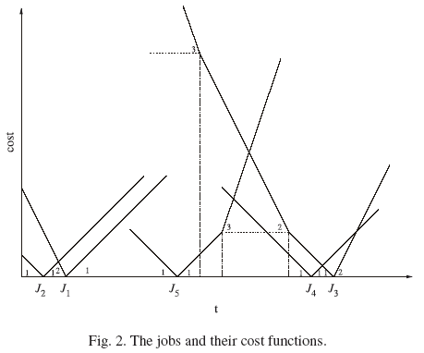
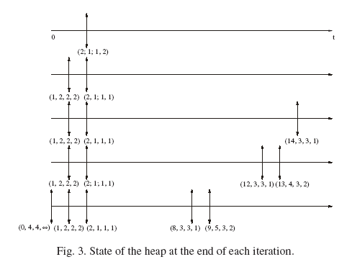
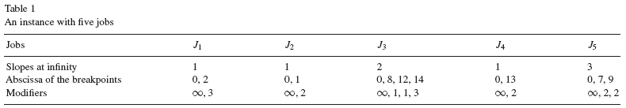
Example

Slide 7
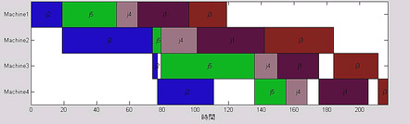
Permutation Flow Shop
The flow shop problem consists of n jobs. A job J_{i} is made of M successive operations O_{i},1, . . . , O_{i,M} where operation O_{i,j} is executed without preemption by the machine M_{j} and has a processing time p_{i,j} .
In the permutation flow shop, every machine performs the jobs in the same order.
圖片出處: http://static.flickr.com/74/175952168_17fc6e8d63.jpg

Slide 8
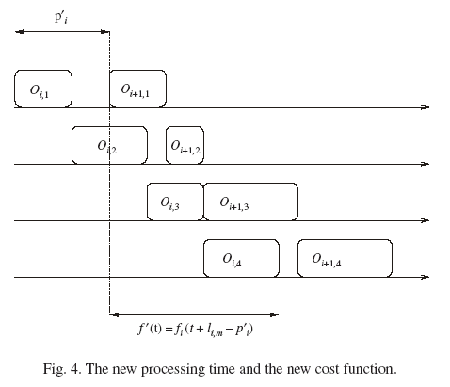
The New Cost Function
No-Wait: One way to penalize the storage cost is to ban idle time between operations of the same job.
Finding all the critical operations is done in O(nM).
The global complexity is then O(max(nM,mlog n)).

Slide 9
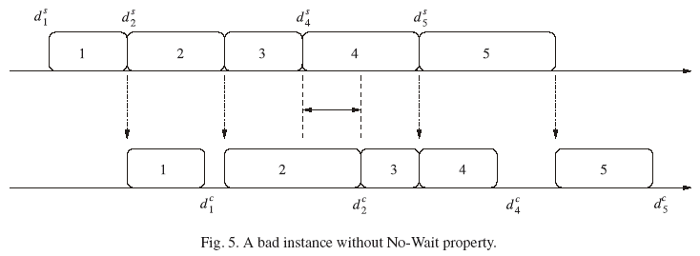
A bad instance without No-Wait property
There is no optimal solution where the third job has the No-Wait property.

